Slide 1

DIDACTIC OFFER for the AA - 2022/23
Università Politecnica delle Marche
Scuola di Dottorato in Scienze dell’Ingegneria
Monday, November 14th, 2022
Aula Azzurra
h. 16.30-17.00
Prof. Nicola Paone - Director of the Doctoral School in Engineering Science
with participation of:
Prof. Giovanni Di Nicola - Coordinator of Doctorate course in Industrial Engineering
Prof. Franco Chiaraluce– Coordinator of Doctorate course in Information Engineering
Prof. Francesco Fatone - Coordinator of Doctorate course in Civil, Env. Eng. and Architecture

Slide 2
Outline
introduction
purpose of the didactic offer
minimum attendance requirements
organizational aspects (attendance, Moodle, web-streaming, ….)
courses offered for AA-22/23
  objectives and programmes
  timetable

Slide 3
Introduction
Why undertaking a PhD ?
To become a professional researcher:
A PhD is a relevant qualification to pursue:
a career in academia (here PhD is mandatory)
a career in research institutions (here PhD is highly appreciated)
a career in innovative companies (industrial or services) (a PhD degree can be a booster for starting a career)

Slide 4
Introduction
A good PhD graduate is much more than a good researcher !!
Main characteristics of a successful PhD graduate:
analytical and research skills
autonomy and independent thinking
team working
management skills (planning, monitoring, controlling complex activities)
communication skills
leadership

Slide 5
The PhD School in Engineering Science
Purpose: coordination of activities of the three Doctoral Courses offered by the Faculty of Engineering:
Doctorate course in Civil, Env. Eng. and Architecture
Doctorate course in Industrial Engineering
Doctorate course in Information Engineering

Slide 6
Purpose of the didactic offer
Organize occasions where PhD students of different courses meet together
Stimulate interest beyond your specific field of research – widen-up your perspective
Comply to legal requirements
DM-301 del 23-2-22 (art. 3.2) «……attività, anche in comune tra più corsi di dottorato, di formazione interdisciplinare, multidisciplinare e transdisciplinare (perfezionamento linguistico e informatico; attività nel campo della didattica, della gestione della ricerca e della conoscenza dei sistemi di ricerca europei e internazionali, della valorizzazione e disseminazione dei risultati, della proprietà intellettuale e dell'accesso aperto ai dati e ai prodotti della ricerca, dei principi fondamentali di etica, uguaglianza di genere e integrità.»

Slide 7
Purpose of the didactic offer
The Doctoral School in Engineering Science has started offering a set of courses since 2010
Mix of:
  transversal course
  disciplinary courses
Offer slightly changes from year to year
IMPORTANT: at PhD level, didactic should be a stimulus for your personal growth – you are then expected to deepen your knowledge independently

Slide 8
Minimum attendance requirements
During their first year of doctorate, doctoral students are required to follow at least two courses chosen from those listed below (in agreement with your supervisor).
The attendance will be checked by collecting signatures (QR code) in the classroom and the PhD student is required to attend at least 75% of the course hours.
The verification of the acquired knowledge will be carried out according to the procedures defined by the individual professors.

Slide 9
Where to find information
Central web-site of UNIVPM https://www.univpm.it/Entra/Ricerca/Dottorato_di_Ricerca_/Didattica_comune
Web-site of Engineering faculty https://www.ingegneria.univpm.it/content/scuola-di-dottorato-scienze-dellingegneria?language=it

Slide 10
Courses offered for AA-22/23
Organizational aspects: web-streaming/recording
Courses will be held in presence
Course will also be provided in live web-streaming
We will use Microsoft TEAMS
  Slides
  Video
  Audio
A specific TEAM for each course will be created by each professor and made available to PhD students enrolled in the course (generally through the Learn environment)
Recorded files could be made available on Learn for download and delayed play-back
BEWARE ABOUT CONNECTION AND BANDWIDTH AND EQUIPMENT

Slide 11
Courses offered for AA-22/23
Organizational aspects: proof of attendance
When in classroom, scan the QR code generated during each lesson
  Install an App for QR code reading on your cell-phone
  When you sign-up, USE your PhD credentials (not the one you had when you were an undergraduate student !
  If errors occurr, your professor will be able to record your attendance manually
If you follow through web-streaming, scan the QR code on a sufficiently large screen
In case of delayed attendance (download and play-back of recorded lessons), take proper arrangements with your professor (delayed attendance should be avoided and in any case it is considered as an unusual emergency attendance mode)

Slide 12
QR code generator
https://prodapps.econ.univpm.it/registro_dottorandi/index.php

Slide 13
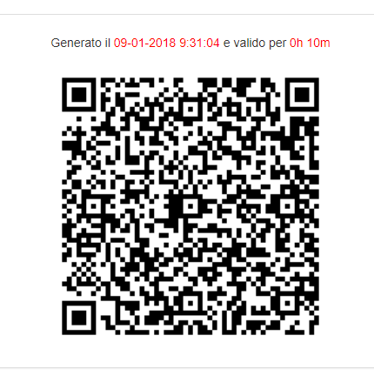
Lesson 1
In order to sign your attendance, scan this QR code and follow the instructions (you need to be connected to the web)

Slide 14

Recording of Attendance

Slide 15
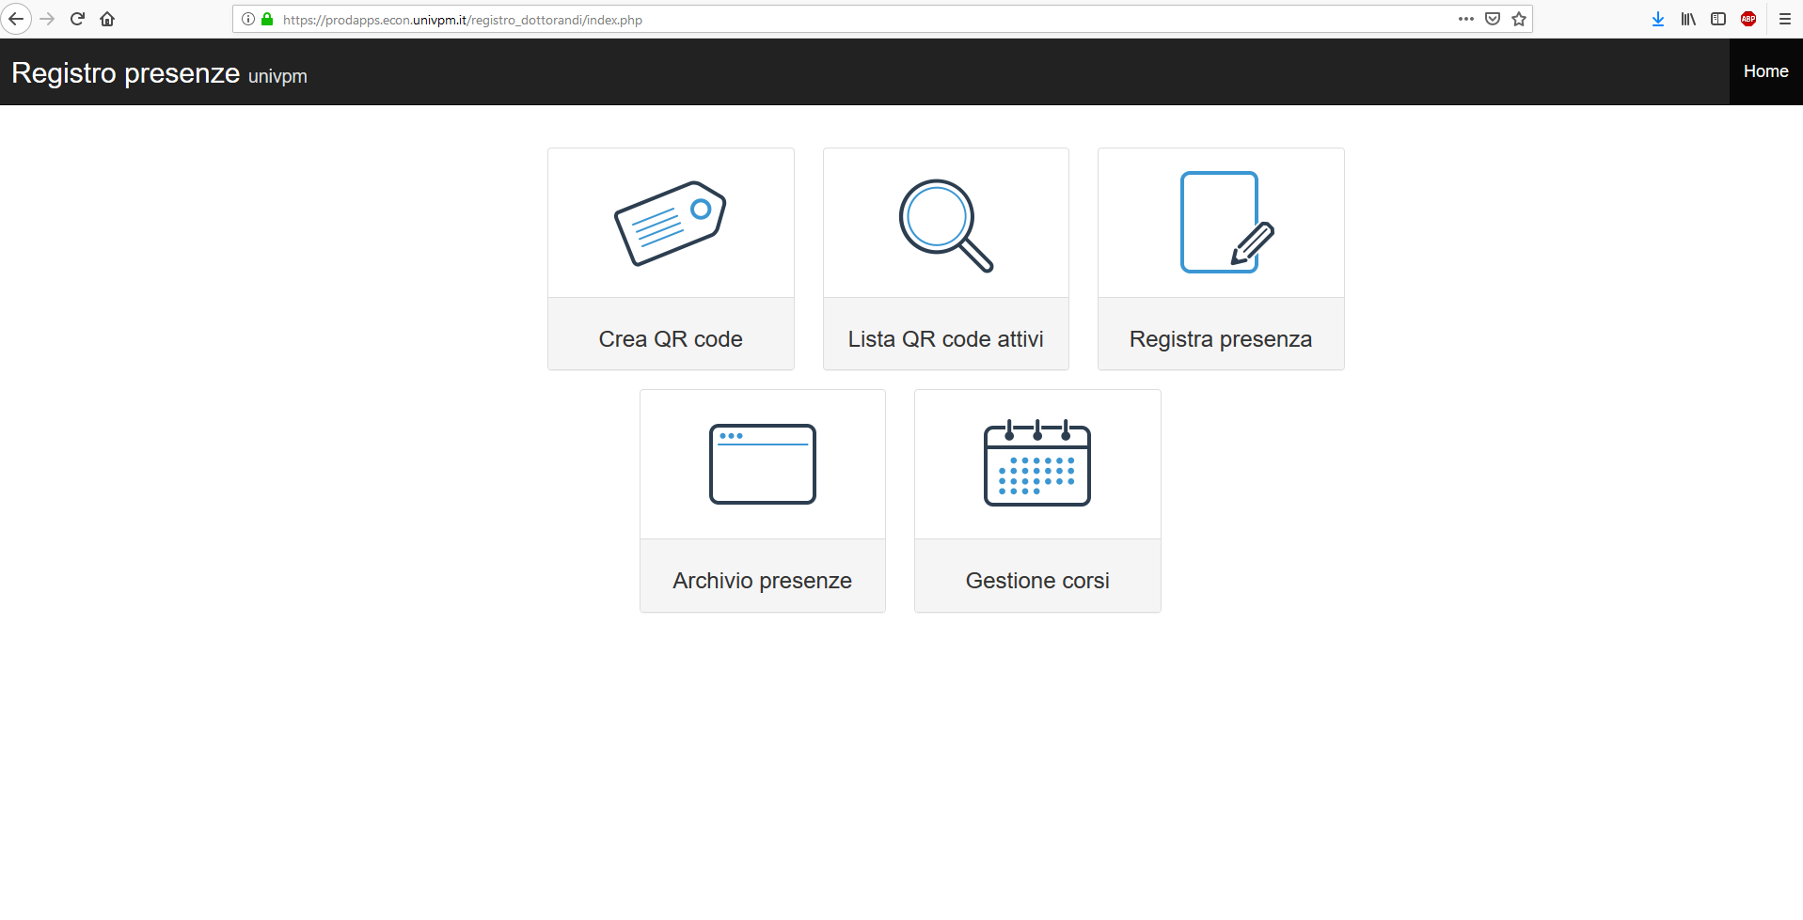
The Professor will begin the attendance registration procedure by clicking on «Crea QR code».

Slide 16
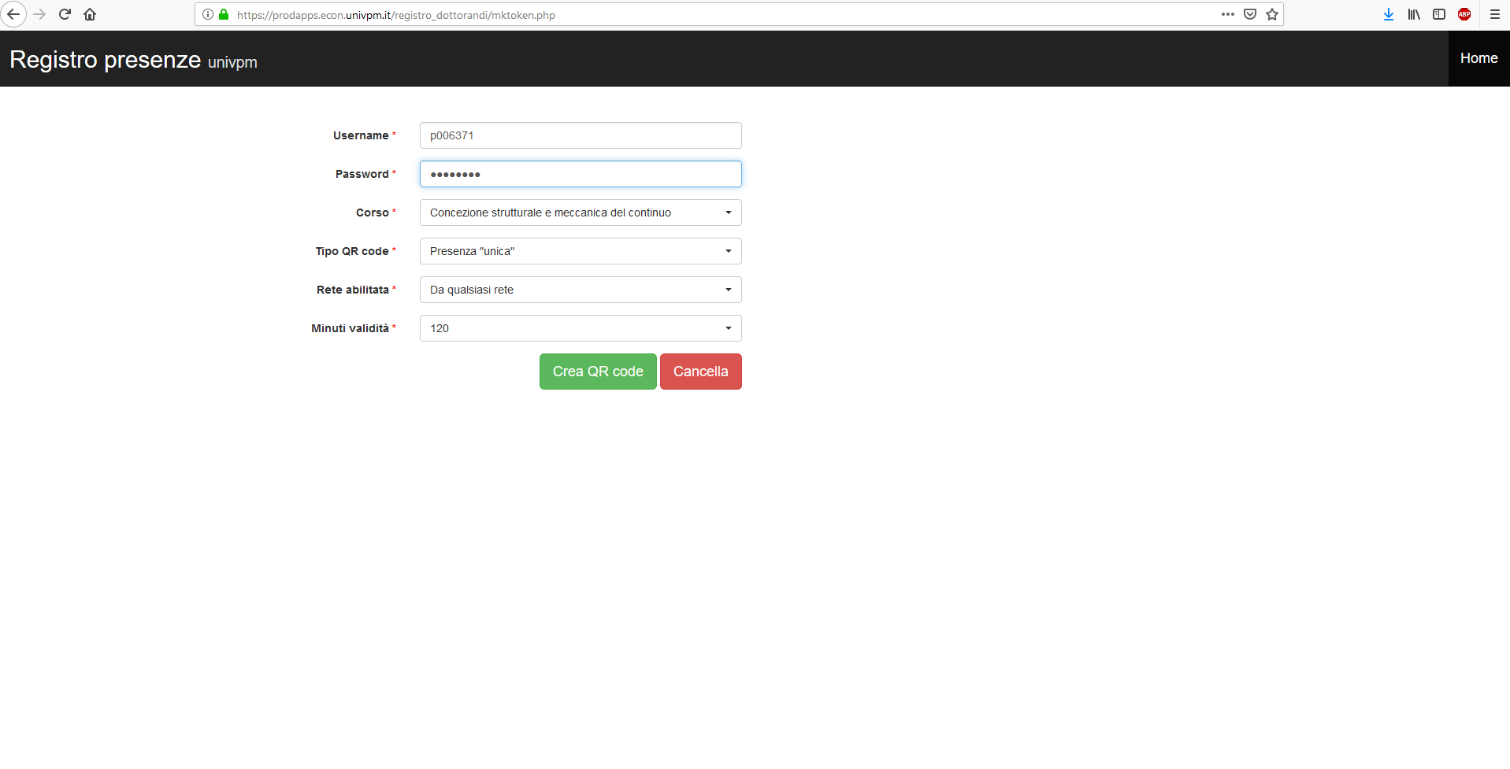
The professor will create a QR code by entering the required information.

Slide 17
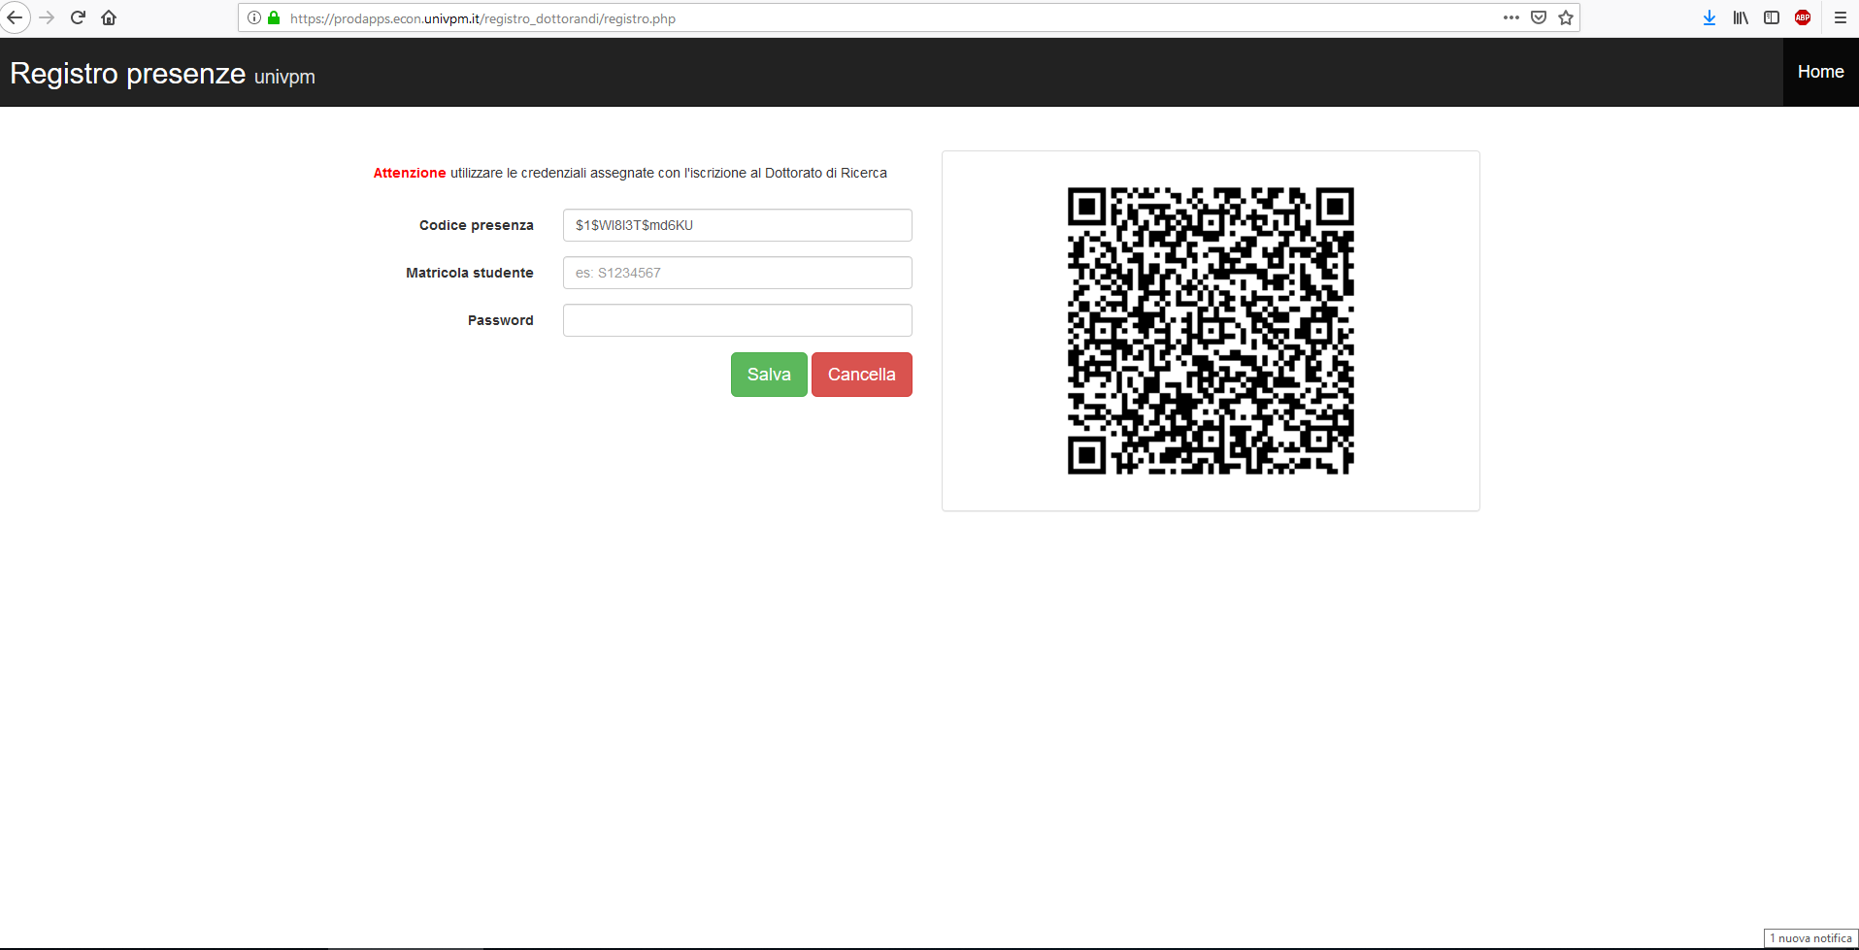
Phd Students will have to scan the Qr Code using their mobile phone.

Slide 18
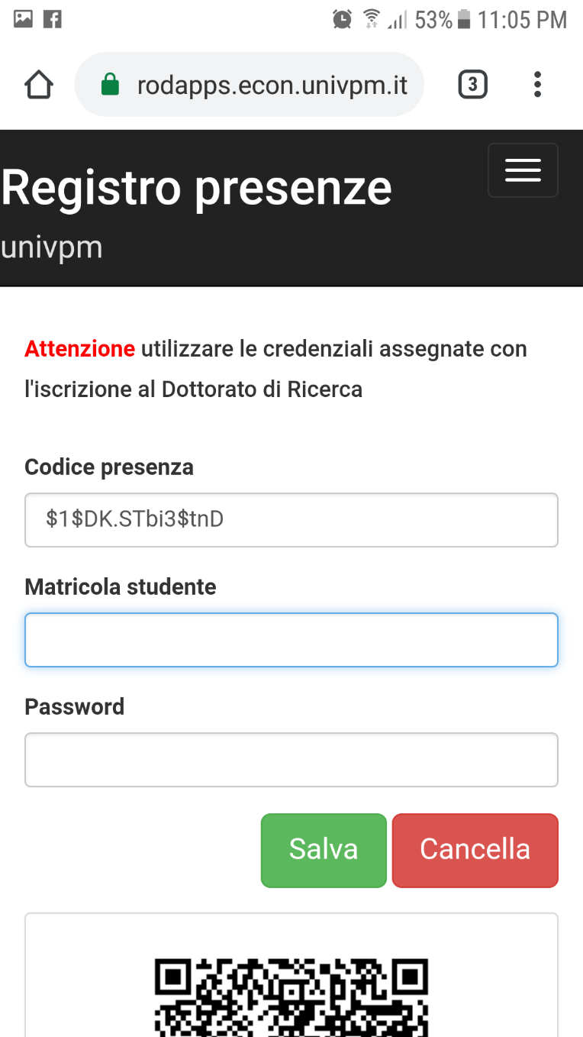
Please, fill in the fields with the credentials used to access your account on the "esse3web" platform.
S1234567
…….

Slide 19
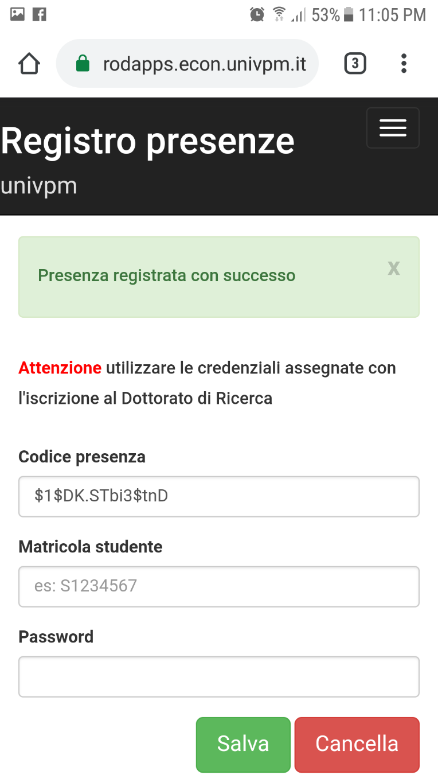
Please, check that the procedure has been successfully completed.

Slide 20
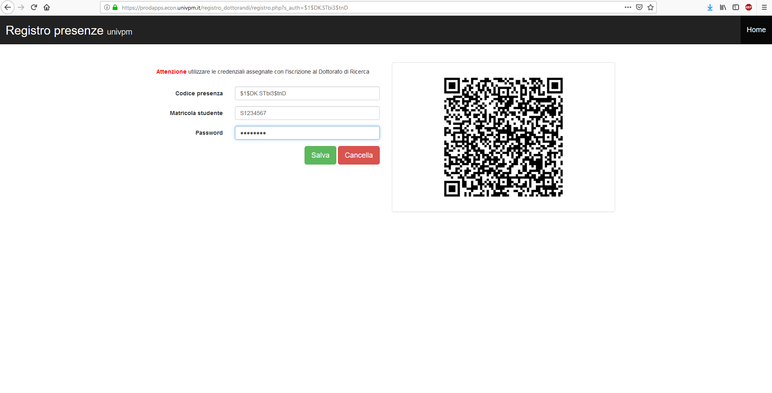
Phd Students who don't have a mobile phone will have to ask the professor to enter their credentials manually in the attendance register.

Slide 21
Courses offered for AA-22/23
Organizational aspects: Learn environment https://learn.univpm.it/
Each course will make use of Learn environment at different level
In any case:
  Sign-up as participant to the course you are planning to attend it
  Take arrangements and follow instructions of your professor

Slide 22
Courses offered for AA-22/23
List of course, objectives and programmes https://www.ingegneria.univpm.it/didactic-offer-phd-school-engineering-science-2023

Slide 23
Courses offered for AA-22/23
Timetable :

Slide 24
NOW IT IS UP TO YOU !
Be proactive, most of what you will get depends:
- on you,
- on your research team
- on your personal involvement
Now you are a PhD candidate !
For any question, doubt, proposal:
talk to your Tutor or Coordinator of your Doctorate
or to me n.paone@staff.univpm.it

