Slide 1

DIDACTIC OFFER for the AA - 2019/20
Università Politecnica delle Marche
Scuola di Dottorato in Scienze dell’Ingegneria
Tuesday, November 19th, 2019
h. 9.30-11.30
Prof. Nicola Paone - Director of the Doctoral School in Engineering Science
with participation of:
Prof. Giovanni Di Nicola - Coordinator of Doctorate course in Industrial Engineering
Prof. Francesco Piazza – Coordinator of Doctorate course in Information Engineering
Prof. Francesco Fatone - Coordinator of Doctorate course in Civil, Env., Eng. and Architecture

Slide 2
Outline
purpose of the didactic offer
minimum attendance requirements
organizational aspects (attendance, Moodle, web-streaming, ….)
courses offered for AA-19/20
  objectives and programmes
  timetable

Slide 3
Purpose of the didactic offer
Create events where PhD students of different courses meet together
Stimulate interest beyond your specific field of research
Comply to legal requirements
DM-45 (art. 4, comma 1-f) «…… previsione di attività, anche in comune tra più dottorati, di formazione disciplinare e interdisciplinare e di perfezionamento linguistico e informatico, nonché, nel campo della gestione della ricerca e della conoscenza dei sistemi di ricerca europei ed internazionali, della valorizzazione dei risultati della ricerca e della proprietà intellettuale.»

Slide 4
Purpose of the didactic offer
The Doctoral School in Engineering science has started offering a set of courses since 2010
Mix of:
  transversal course
  disciplinary courses
Offer may change from year to year
IMPORTANT: at PhD level, didactic should be a stimulus for your personal growth – you are then expected to deepen your knowledge independently

Slide 5
Minimum attendance requirements
During their first year of doctorate, doctoral students are required to follow at least two courses chosen from those listed below (in agreement with your supervisor).
The attendance will be checked by collecting signatures (QR code) in the classroom and the PhD student is required to attend at least 75% of the course hours.
The verification of the acquired knowledge will be carried out according to the procedures defined by the individual professors.

Slide 6
Where to find information
Central web-site of UNIVPM https://www.univpm.it/Entra/Ricerca/Dottorato_di_Ricerca_/Didattica_comune
Web-site of Engineering faculty https://www.ingegneria.univpm.it/content/scuola-di-dottorato-scienze-dellingegneria?language=it

Slide 7
Courses offered for AA-19/20
Organizational aspects: web-streaming/recording
Most course will allow live web-streaming
Skype for business
  Slides
  Video
  Audio
Links to each Lesson will be created by each professor and made available to PhD students enrolled in the course (generally throgh the Learn environment)
Recorded files (*.mp4 – very heavy !!) could be made available on Learn for download and delayed play-back
BEWARE ABOUT CONNECTION AND BANDWIDTH AND EQUIPMENT

Slide 8
Courses offered for AA-19/20
Organizational aspects: proof of attendance
When in classroom, scan the QR code generated during each lesson
  Install an App for QR code reading on your cell-phone
  When you sign-up, USE your PhD ID number (not the one you had when you were an undergraduate student !
  If errors occurr, your professor will be able to record your attendance manually
If you follow through web-streaming, pay attention to scan the QR code on a sufficiently large screen
In case of delayed attendance (download and play-back of recorded lessons), take proper arrangements with your professor (delayed attendance should be avoided and in any case it is considered as an unusual emergency attendance mode)

Slide 9
QR code generator
https://prodapps.econ.univpm.it/registro_dottorandi/

Slide 10
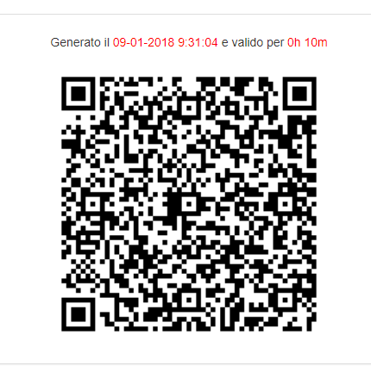
Lesson 1
In order to sign your presence, scan this QR code and follow the instructions (you need to be connected to the web)

Slide 11

Recording of Attendance

Slide 12
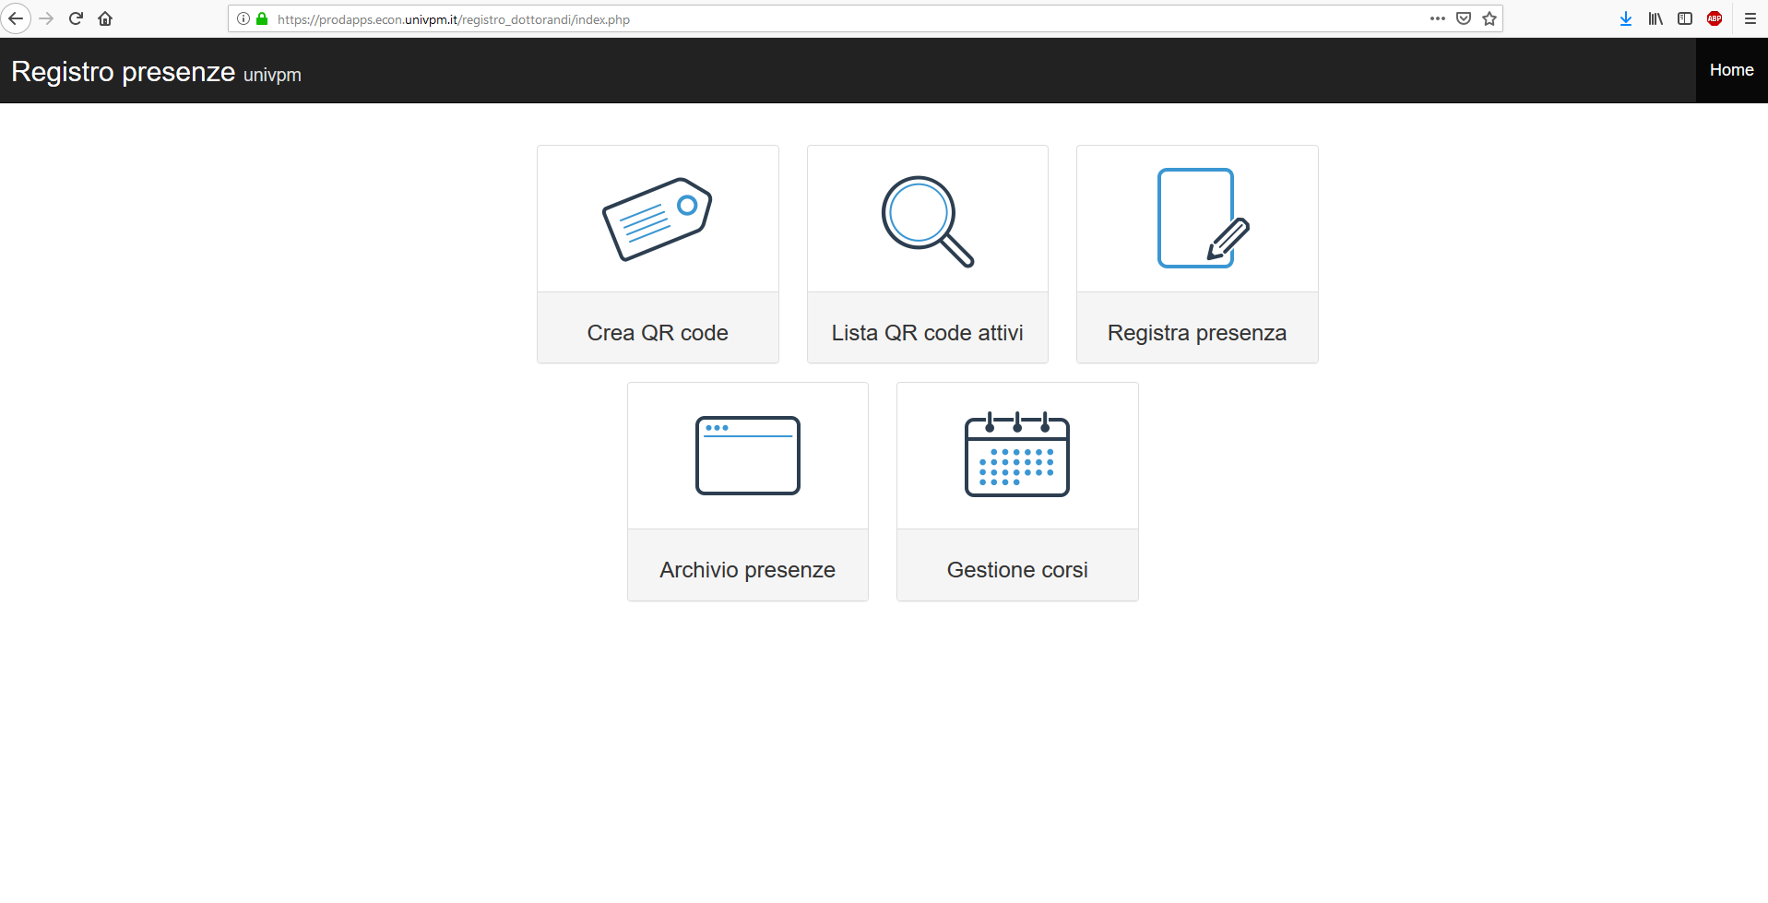
The Professor will begin the attendance registration procedure by clicking on «Crea QR code».

Slide 13
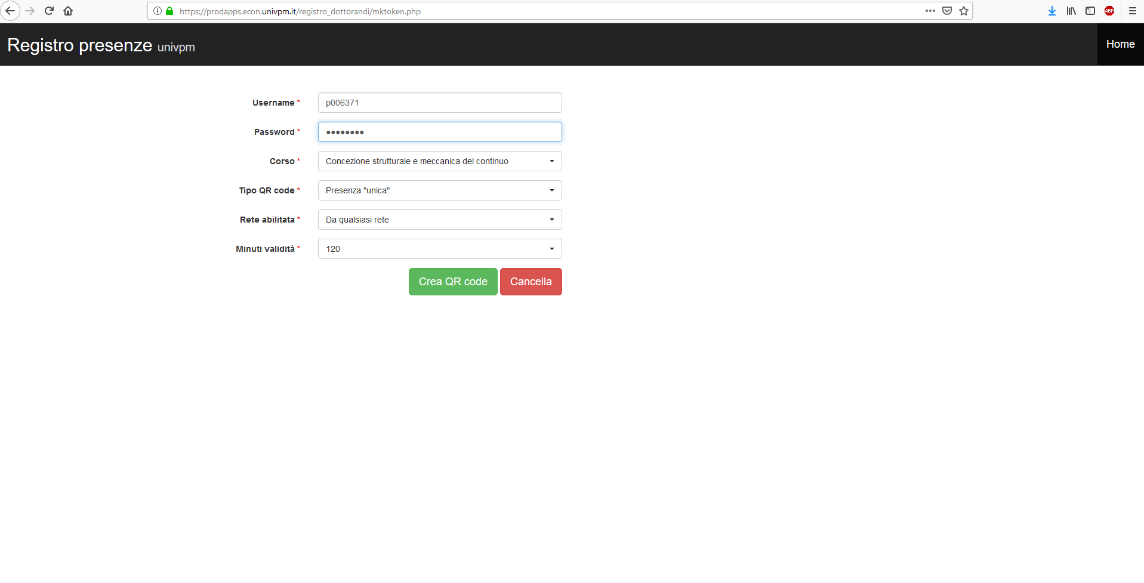
The professor will create a QR code by entering the required information.

Slide 14
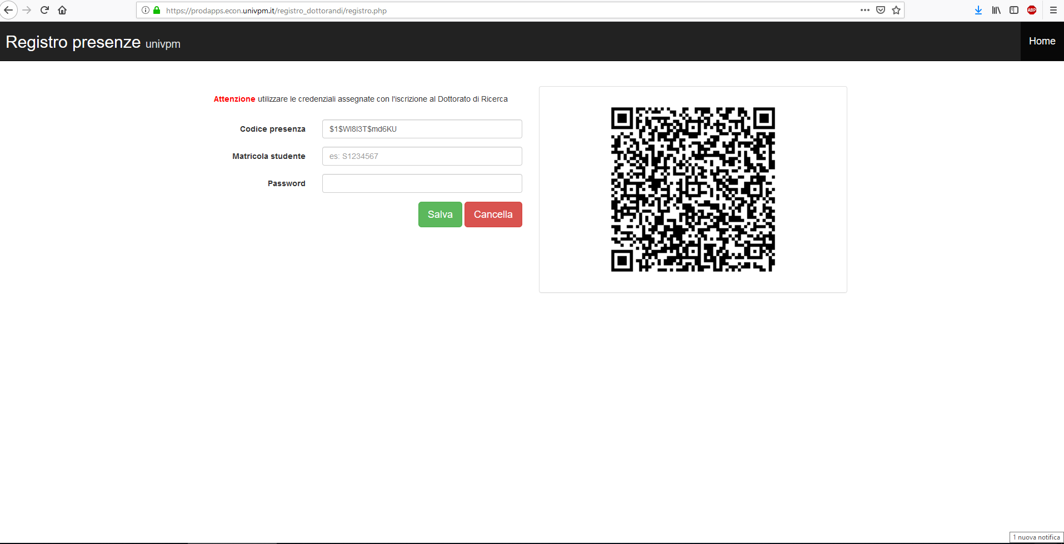
Phd Students will have to scan the Qr Code using their mobile phone.

Slide 15
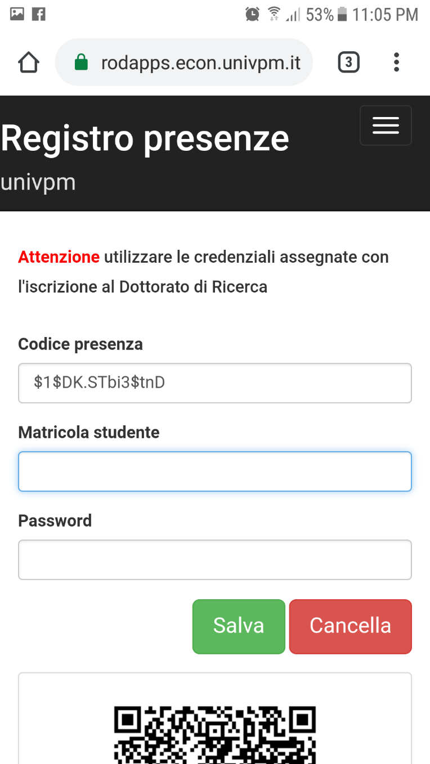
Please, fill in the fields with the credentials used to access your account on the "esse3web" platform.
S1234567
…….

Slide 16
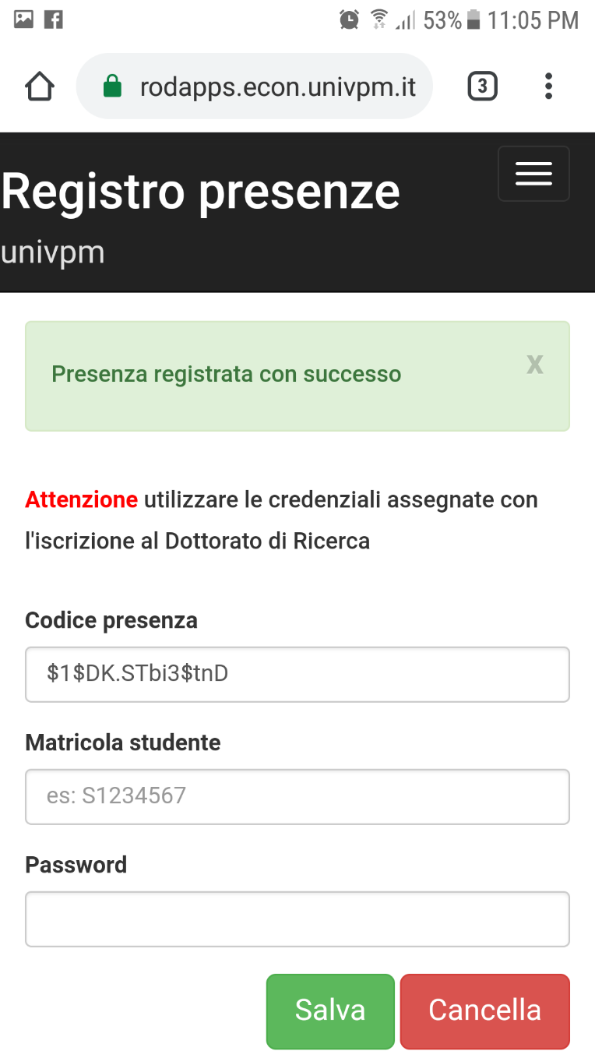
Please, check that the procedure has been successfully completed.

Slide 17
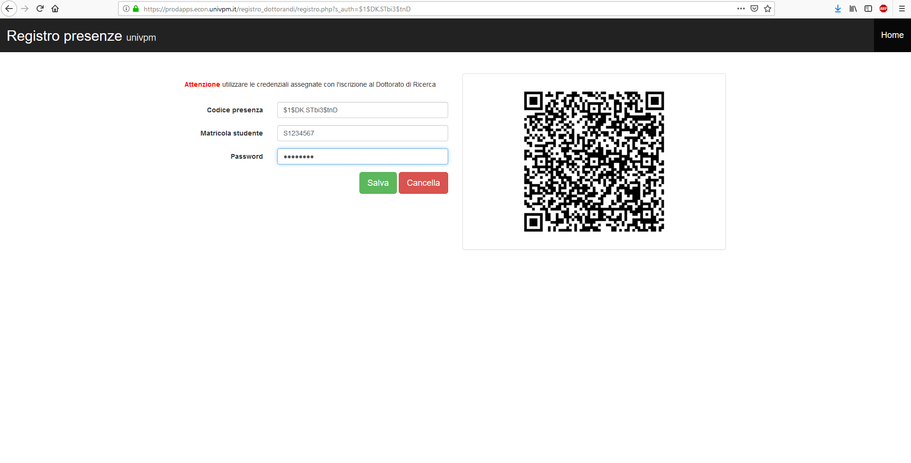
Phd Students who don't have a mobile phone will have to enter their credentials manually in the attendance register.

Slide 18
Courses offered for AA-19/20
Organizational aspects: Learn environment https://learn.univpm.it/
Each course will make use of Learn environment at different level
In any case:
  Sign-up as participant to the course you are following
  Take arrangements and follow instructions of your professor

Slide 19
Courses offered for AA-19/20
List of course, objectives and programmes
N. | COURSE | CODICE | DOCENTE | LINK al sito https://learn.univpm.it/
1 | ECONOMICS AND MANAGEMENT OF TECHNOLOGY TRANSFER | DOT-19/20-CCA-01 | Donato Iacobucci | https://learn.univpm.it/course/view.php?id=8134
2 | DESIGN OF RESEARCH: EUROPEAN PROJECTS | DOT-19/20-CCA-02 | Nicola Paone | https://learn.univpm.it/course/view.php?id=8135
3 | TOOLS AND METHODS FOR PROCESS REPRESENTATION AND MANAGEMENT | DOT-19/20-SDSI-01 | Ferruccio Mandorli | https://learn.univpm.it/course/view.php?id=8136
4 | PROJECT MANAGEMENT TECHNIQUES | DOT-19/20-SDSI-02 | Filippo Ciarapica | https://learn.univpm.it/course/view.php?id=8137
5 | VIRTUAL INSTRUMENTS (LABVIEW) FOR MONITORING AND MANAGEMENT OF INDUSTRIAL SYSTEMS | DOT-19/20-SDSI-03 | Paolo Castellini | https://learn.univpm.it/course/view.php?id=8138

Slide 20
Courses offered for AA-19/20
List of course, objectives and programmes
6 | ADVANCED VIRTUAL INSTRUMENTS (LABVIEW - MATLAB) FOR SIMULATION AND CONTROL OF COMPLEX SYSTEMS | DOT-19/20-SDSI-04 | David Scaradozzi | https://learn.univpm.it/course/view.php?id=8139
7 | FROM CONTINUUM TO STRUCTURAL MECHANICS | DOT-19/20-SDSI-05 | Fabrizio Davì | https://learn.univpm.it/course/view.php?id=8140
8 | CULTURAL HERITAGE: TRADITION AND INNOVATION | DOT-19/20-SDSI-06 | Antonello Alici | https://learn.univpm.it/course/view.php?id=8141
9 | MATHEMATICAL PROGRAMMING AND GRAPH THEORY | DOT-19/20-SDSI-07 | Fabrizio Marinelli | https://learn.univpm.it/course/view.php?id=8142
10 | ELECTRON MICROSCOPY TECHNIQUES AND MICROANALYSIS | DOT-19/20-SDSI-08 | Gianni Barucca | https://learn.univpm.it/course/view.php?id=8143
11 | DISCRETIZATION OF DIFFERENTIAL EQUATIONS FOR COMPUTATIONAL MECHANICS | DOT-19/20-SDSI-09 | Andrea Crivellini | https://learn.univpm.it/course/view.php?id=8144
12 | OPEN SOURCE SCIENTIFIC SOFTWARE: LATEX AND OCTAVE | DOT-19/20-SDSI-10 | Riccardo (Jack) Lucchetti, Giulio Palomba, Giulia Bettin, Matteo Picchio, Claudia Pigini (LaTeX), Marco Baldi (Octave) | https://learn.univpm.it/course/view.php?id=8145

Slide 21
Courses offered for AA-19/20
List of course, objectives and programmes
Programmes: CORSI_Dottorato_Programmi_AA19-20_v4.docx

Slide 22
Courses offered for AA-19/20
Timetable: GANTT_Corsi_2019-20_v6.xlsx

Slide 23
THANK YOU
For further needs:
n.paone@univpm.it
Or your Coordinators

